Slide 1
The Digital War Room approach unlocked a 20% increase in operating income
GEM | America
CHA0136
Client context
Approach
Impact
Rapid ramp-up and rollout of both pricing and sales growth implementations, with new tools in the field in as little as 3 weeks
Leveraged agile organization principles to source and scale ideas from the field
Tools fully integrated into client data systems with custom MDL functionality
“War room” execution cadence held at all levels of sales org each week
Extensive gamification and visual performance management- including an interactive 3D physical war room
Analyzed 10m+ invoice lines and 300k+ product/customer combinations
Changed prices on >100k product/customer combinations
Trained >400 reps and managers
Launched field workshops in three weeks, where field committed to price changes worth 25-40% of target in 2 hours
Custom coding created to integrate Tableau and SFDC
Full pricing analytics refreshed weekly; churn & growth analytics refreshed daily
Incorporated tools into interactive 3D war room, used for all senior management meetings
On track to deliver >300bps improvement in margins – with $1-2M annual run-rate improvements still seen weekly
20% increase in operating income
No elasticity impact observed in customers impacted by price changes
500 bps churn improvement in first month after churn reduction tool roll-out
Where is the impact opportunity …
Decentralized field sales forces, with large number of products and/or customers. E.g.:
Distribution companies (tech, pharma, GEM, etc.)
Aftermarket companies
SMB-focused companies
RTS or other at-risk programs
Client name: X
Team set-up: X
Fees Structure: X
What was unique: X

Slide 2
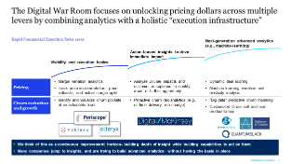

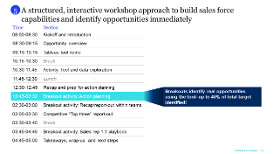
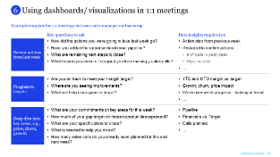
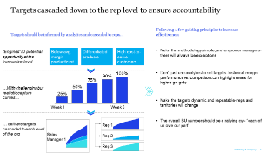
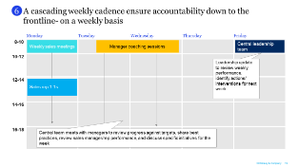
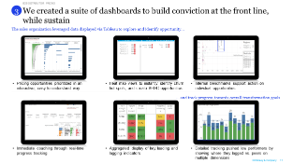
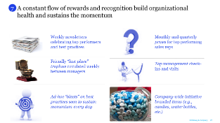
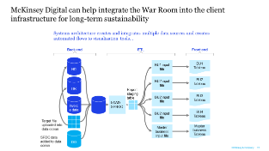
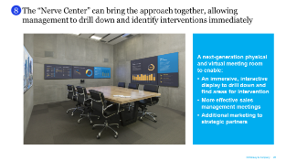
Soup up your Performance Engine with the Digital War Room
B2B Distributor DIGITAL SALES TRANSFORMATION
Digitally automate and integrate advanced analytics and visualization tools to ID opportunity and track progress
Combine a relentless execution mindset with capability building and focus on soft factors to make it stick
Advanced analytics to identify and prioritize granular opportunities
Front-line training to build conviction and confidence
1
5
Create accountability by setting targets at the rep level
An RTS-like execution cadence to drive accountability and results
2
6
Interactive visualizations
to create buy-in, and
track progress
Creative rewards and recognition
3
7
Full integration into client data systems to create
real-time data and sustain the change
Surrounded by a next-gen digital “nerve center”
4
8
McKinsey & Company
2

Slide 3








Where is this applicable?
Who should I talk to?
What resources are available?
Roland John, Senior Partner
Decentralized field sales forces, with large number of products and/or customers. E.g.:
Distribution companies (tech, pharma, GEM, etc.)
Aftermarket companies
SMB-focused companies
RTS or other at-risk programs
Full CXO document with deep dives for each “cylinder”
Go-and-see availability at a client who has been through the transformation
Under development: full interactive mock-up war room using Oblong hardware in McKinsey offices (e.g., Chicago)
Georg Winkler, Partner
Wilson McCrory, Partner
Prasoon Sharma, Digital Partner
Malcolm Smith, Digital Expert
Warren Davis,
Engagement Manager
Shivani Kumar, Engagement Manager
Julie Duregger,
Engagement Manager
McKinsey & Company
4

